Slide 1

The Pursuit of Happiness
Project By:
Carly Osborne
Evan Johnson
Mohamed Bedreddine
Rima Philip
Alex Chao
A data visualization project on the United Nations yearly World Happiness Report.

Slide 2

The World Happiness Report
Changing World Happiness
World Happiness Report focuses on happiness and the community
How happiness has evolved over the past dozen years, with a focus on the technologies, social norms, conflicts and government policies that have driven those changes.
Countries are ranked each year based on a Happiness Index. This index rates the happiness of countries on a scale from 0 to 10
A landmark survey of the state of global happiness that ranks 156 countries by how happy their citizens perceive themselves to be.

Slide 3

The factors
What factors are used to measure the happiness index?
There are 6 main factors which are corelated:
GDP per capita (GDP divided by population)
Family/Social Support
Healthy Life Expectancy
Freedom to make life choices
Generosity
Perceptions of corruption
Notes:
GDP: most accepted method of determining a country's level of wealth
Social Support: "If you were in trouble, do you have relatives or friends you can count on to help you whenever you need them, or not?“
Life Expectancy: The estimate for the healthy life expectancy represents the average number of "healthy" years a child at birth is estimated to live. It's calculated by the WHO based on over 100 different health factors.
Freedom: "Are you satisfied or dissatisfied with your freedom to choose what you do with your life?"

Slide 4
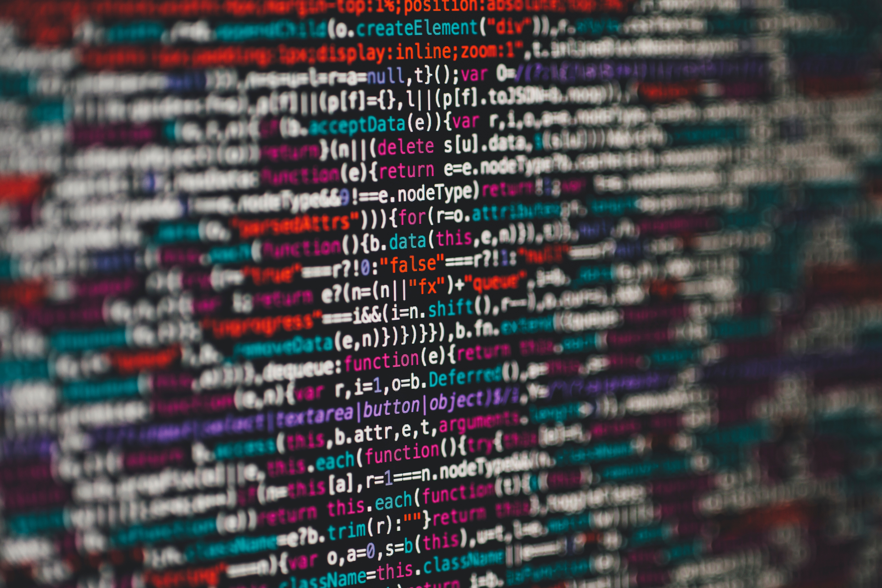
Dataset & the Database
The Extract-Transform-Load process

Slide 5



Extract > Transform > Load
Data Source : https://www.kaggle.com/unsdsn/world-happiness
Datasets (2015, 2016, 2017 & 2018) | Database: Postgres
Extraction & Transform
Load
Nulla a erat eget nunc hendrerit ultrices eu nec nulla. Donec viverra leo aliquet, auctor quam id, convallis orci.
Sed in molestie est. Cras ornare turpis at ligula posuere, sit amet accumsan neque lobortis.
Maecenas mattis risus ligula, sed ullamcorper nunc efficitur sed.
Praesent venenatis quam tortor, viverra nunc rutrum.
Maecenas malesuada ultricies sapien sit amet pharetra.
Nunc tempus, risus sodales hendrerit, arcu dolor commodo libero, a sollicitudin quam nulla quis lectus. In at porta mauris.
Deriving SQLite
Used Python…

Slide 6

Data Visualization
Interactive visualizations to explore the World Happiness data.

Slide 7
The Application | JavaScript - Python - SQLite
Heroku App link : TBD
Front End
Server
Backend
App Routes | Pages
HTML/CSS
Bootstrap
JavaScript
Json
Python
Flask powered RESTful API
SQLite
Route1
World Map & Scatter Plot
Route 2
Horizontal Stacked Bar Chart
Route 3
Data Page
JS libraries Used
D3.js
Plotly.js
Chart.js

Slide 8
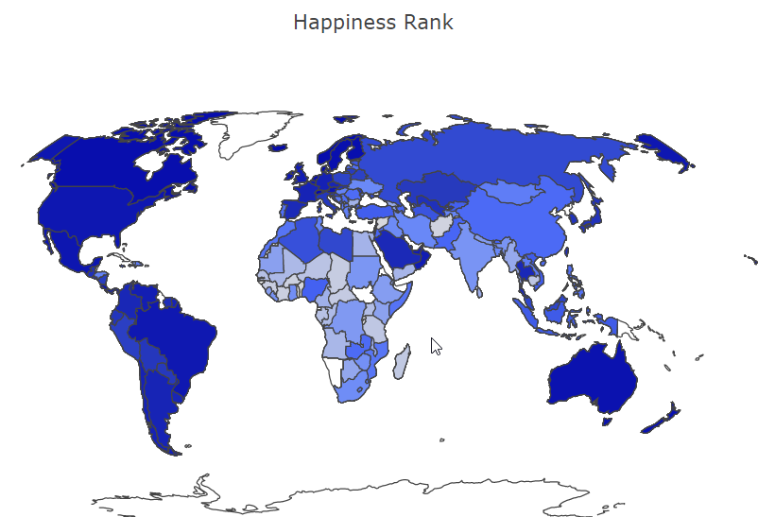
Route 1 | World Happiness Map
World Map showing the variation in the happiness rank. Plotted using D3 and Plotly.

Slide 9
Route1 | Scatter Plot
Scatter Plot

Slide 10
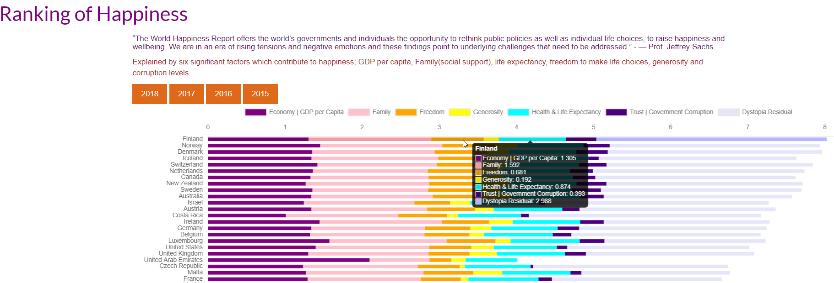
Route 2 | World Happiness Scores
interactive horizontal Stacked Bar Chart plotted using D3 and Chart library.

Slide 11
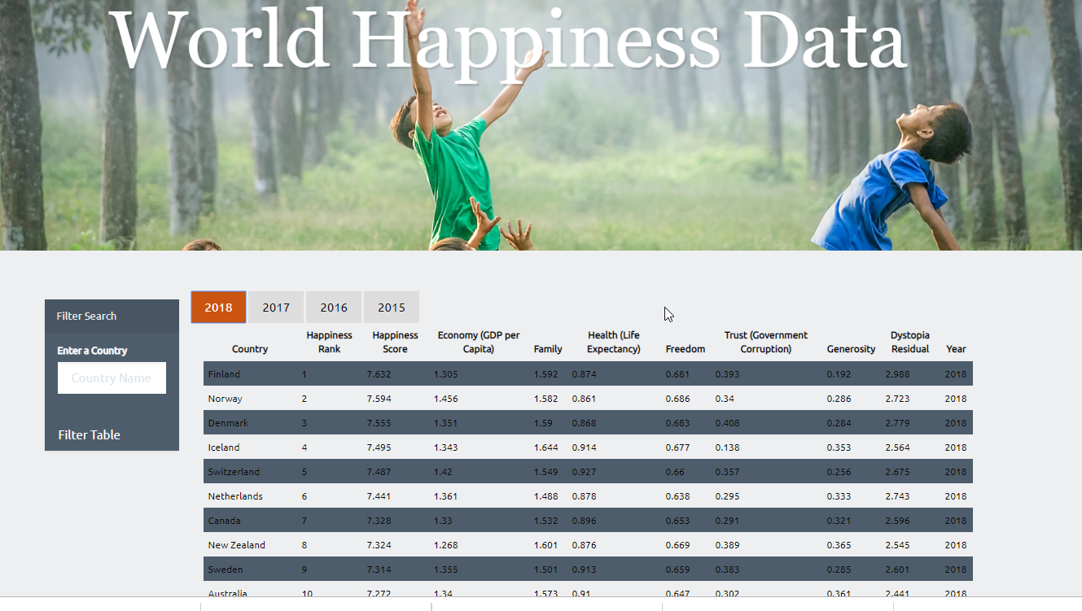
Route 3 | Data Table
Data loaded to an interactive JavaScript table with filtering capabilities

Slide 12
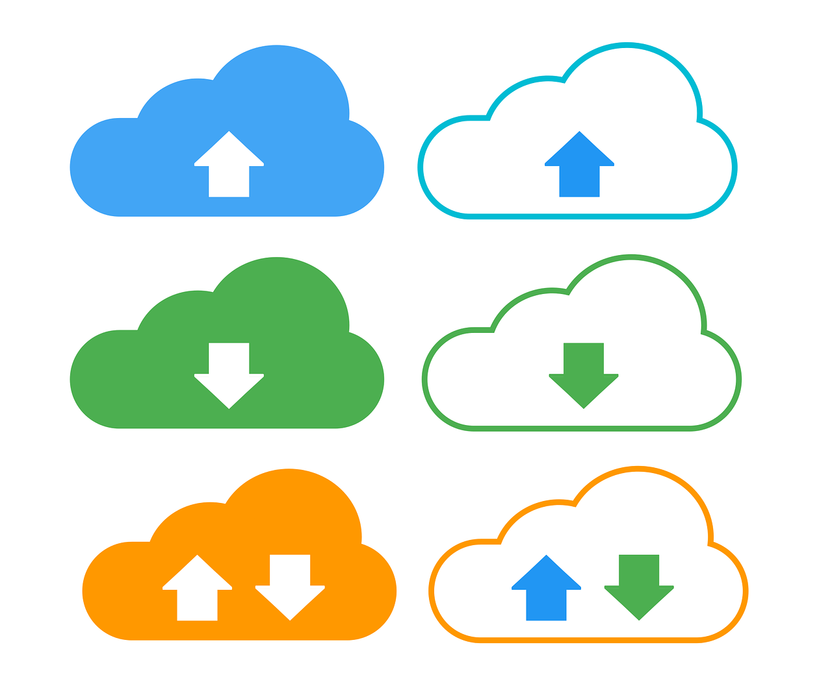
Heroku Deployment
TBD

Slide 13

Thank You
For more info visit https://worldhappiness.report/ed/2019/

